Slide 1
Milestone 2
Group QuantumBlack
Mar 24 2022

Slide 2
Table of contents
Problem Statement and Project Goal
Motivation
Lit Review
Data and some EDAs
Modeling Approach and Choice of Metrics
Baseline Models
Improvement on Baseline
Lesson Learned/Issue Resolved
Upcoming Plans

Slide 3
Problem Statement
We aim to improve prediction timelines through two main methods: applying more complex modeling techniques and regionalizing the continental US to remove granularity in order to provide better aid and preparation to regions before the onset of drought.
Notes:
Current drought predictions are about as accurate as weather forecasts, with accuracy only up to 2-3 weeks.

Slide 4
Project Goals
Review of methods for long-term drought prediction in the continental U.S (CONUS) based on a number of climatrophic data sources
Analyze models based on regional drought prediction across climate regions of the CONUS
Assess how predictability relates to exogenous factors such as county size and population density

Slide 5
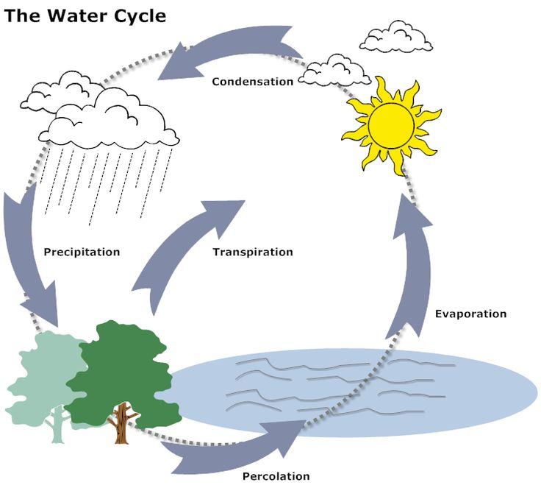
2. Motivation
Droughts have economical, environmental, and human costs caused by water’s importance in natural cycles and our reliance on their products
By improving prediction we can better preparing regions for drought
Long-term rather than short-term regional drought prediction and Regional rather than local forecasting

Slide 6
3. Relevant knowledge & Literature review
Difficulties with drought in general:
Complex causal mechanisms and ambiguous signals
Ault (Science, 2020), On the essentials of drought in a changing climate
Long term drought prediction:
No reliable approach as been developed
Livneh (Nature, 2020), Drought less predictable under declining future snowpack
Recent introduction of ML showing steadily improving prediction capability
Dikshit et al. (Applied Soft Computing, 2022), Artificial neural networks in drought prediction in the 21st century–A scientometric analysis

Slide 7

4. Data List
2012-2022, In weeks, by county
Drought risk
Climate + Satellite predictors for one loc
Name | Category | Feature | Name | Category | Feature
USDM | Y & X | Drought risk | Satellite | X | Change in vegetation area, change in water reservoir size
SET | X | Evaporation, Runoff | NOAA | X | Temperature, Precipitation
SMAP | X | Soil moisture map
Notes:
Our prediction = county basis and predict a week / a couple of weeks into the future
Brunch of datasets that I found. We convert all of this into weekly data and on county level, most of the dataset starting from 2012.
Y = US Drought Monitoring. It is the drought severity index for each county
4 Xs
Spend some time talking abt satellite images

Slide 8
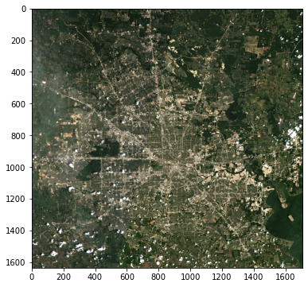
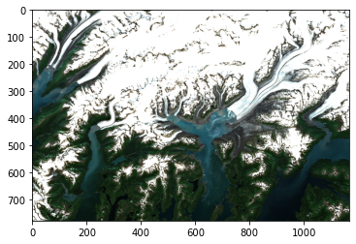
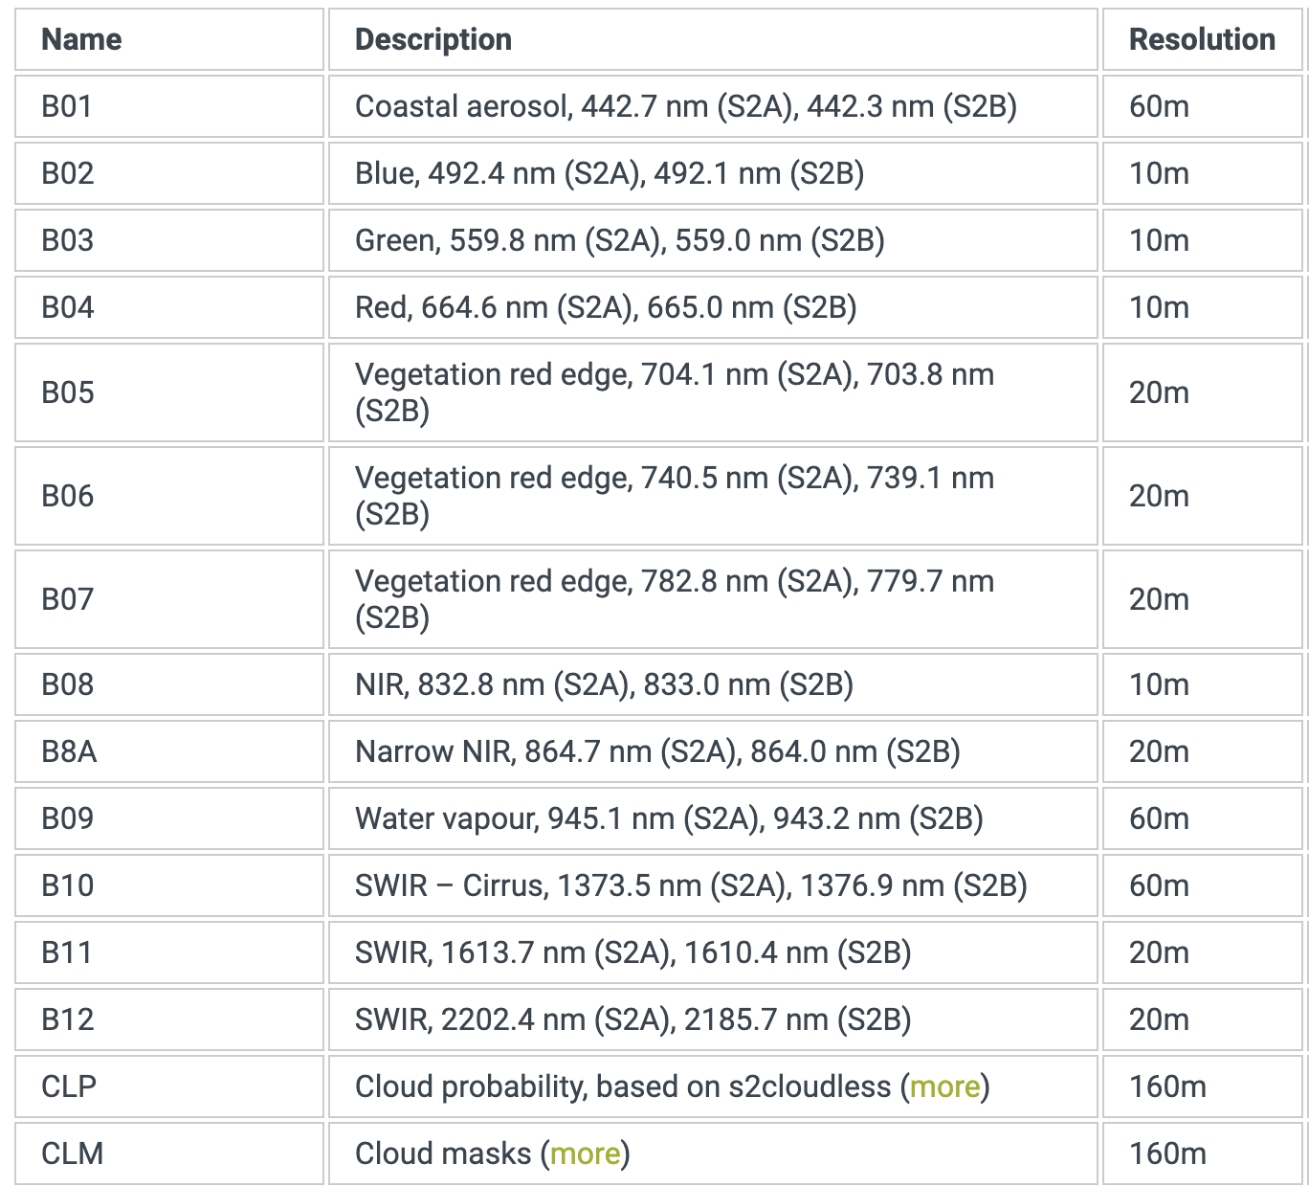
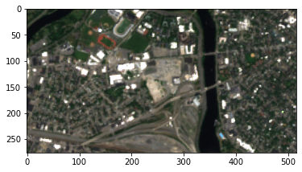
4. Sentinel Hub Satellite Image: Sentinel-2 L2A
Harris, TX 2020-07-15 to 2020-07-20
Alaska 2020-07-15 to 2020-07-20
SEC Harvard 2020-07-15 to 2020-07-20
Notes:
The satellite images that we use is from Sentinel Hub. It offers images globally starting 2017, the satellite is revisiting every 5 days with a resolution of 10 to 60 meters.
After discuss with domain expert and read lit, Two features
Percentage of vegetation area
Each pixel comes with 13 bands as you can see from this chart. We are going to rely on the ones highlighted in red heavility to detect vegetation areas

Slide 9
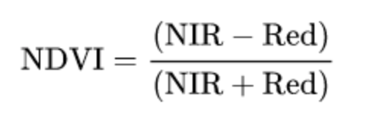
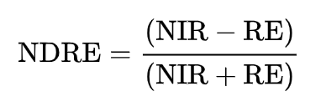
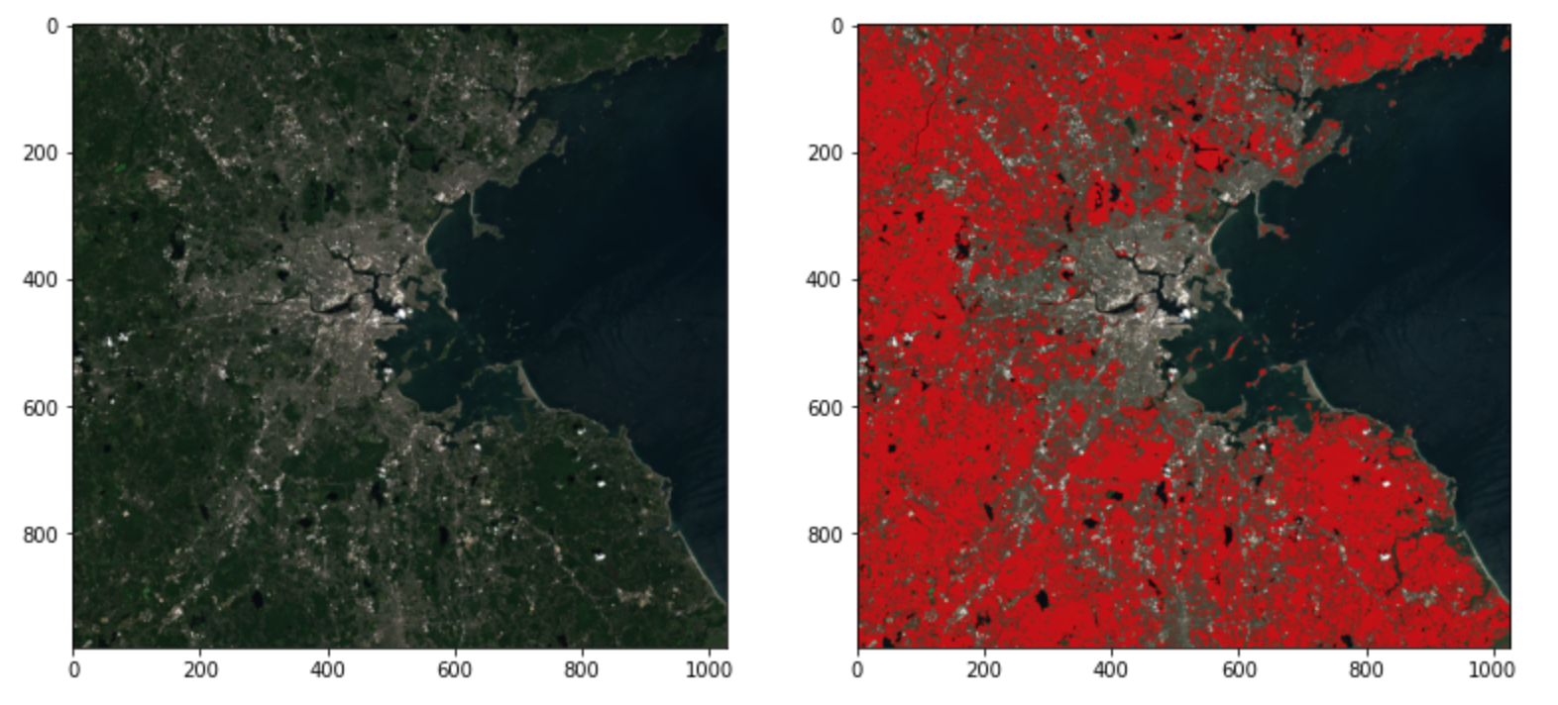
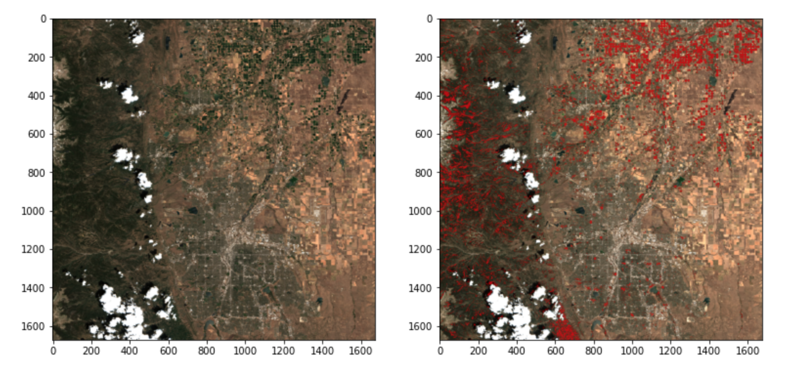
4. Detecting vegetation area in images
Normalized vegetation index (NDVI)
Normalized difference red edge index (NDRE)
Suffolk, MA 2020-07-15, Highlighted by Red when NDVI > 0.8
Broomfield, CO 2020-07-15, Highlighted by Red when NDRE > 0.65
Notes:
Two indices we will use to detect vegetation areas based on literatures and our partner domain experts in sat iamges
NDVI
NDRE
These indices are constructed to detect that
Examples

Slide 10
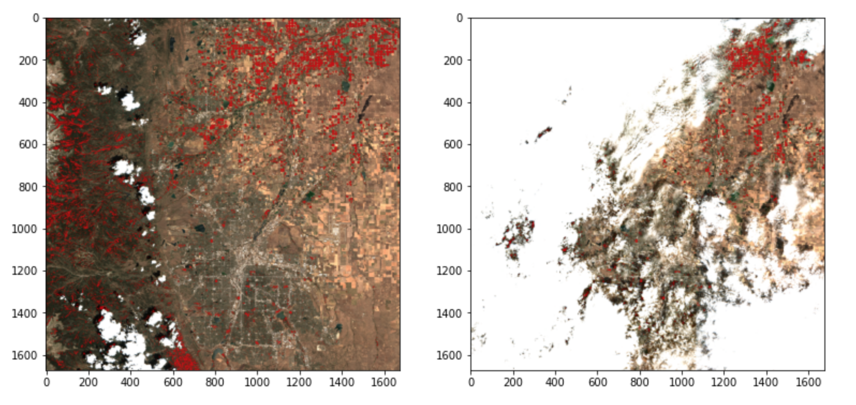
4. Measuring changes in vegetation area between two timeframes
Broomfield, CO July 2020
Broomfield, CO July 2021
Challenge:
Amount of cloud coverage is inconsistent over time, making it difficult to measure the changes in vegetation area over time
Solution:
Use cloud detection to ignore pixels that are covered by clouds in either of the images
8.09% vegetation area
(NDVI > 0.8 and NDRE > 0.65)
7.79% vegetation area
(NDVI > 0.8 and NDRE > 0.65)
Notes:
Our objective is to measure changes in vegetation area between two timeframes
So that we can measure weekly changes in vegetaion area for each county over the past 5 years and use it as our predictors to predict drought risks
Challenges
Example
Solution
Result from these two images

Slide 11

5. Modeling Approach
No prior directions are given
Existing models draw from different sets of data, and uses complex structures (RNNs)
Therefore, we adapt “layer of knowledge” approach:
Y + X1 + X2 +..
Y + X1
Y
Notes:
Reversed pyramid?

Slide 12
5. The metrics for success
R-squared ?
Explained Variation/Total Variation = (1 - Sum of Residual Variation/Total Variation)
Dependent on number of observations and predictors; less informative
Mean Squared Error ✔
The most common and generic metrics
Facilitates comparison (models/ previous studies)

Slide 13
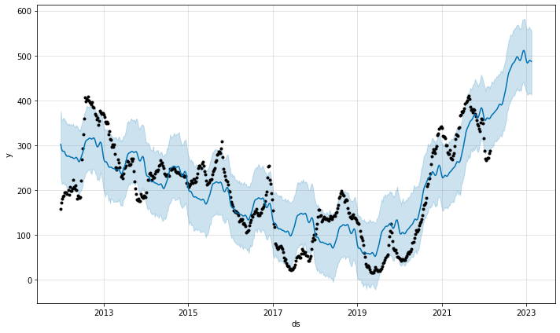
5. Metrics & evaluation process: pooled
On what dataset and how to measure it?
Trivial case for baseline model: pooled (ensamble) country-level drought index
MSE: just the mean squared error of univariate regression
Notes:
How to use these metrics
MSE is very straightforward,
Just the MSE of an univariate regression

Slide 14
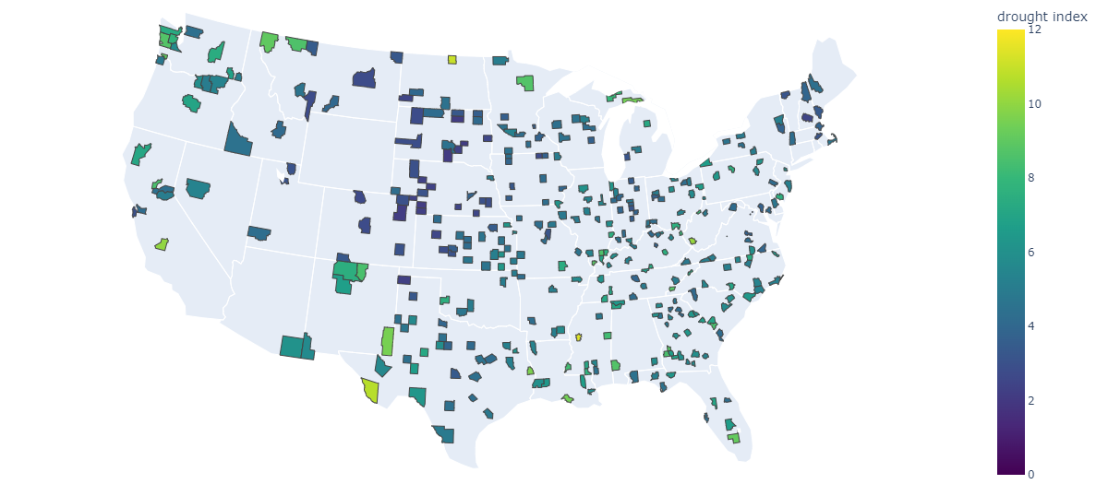
5. Metrics & evaluation process: stratified
Draw counties in a stratified fashion, by 9 climate regions
80% / 20% train test split for counties
Important assumption: counties are weakly independent; no leakage
Conventional: Train on training counties; predict drought index and evaluate MSE on testing counties
Notes:
Stratified modeling approach

Slide 15
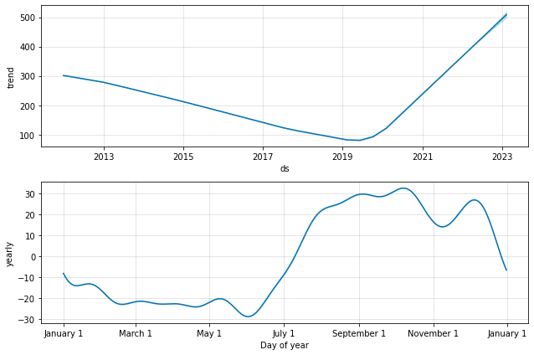
6. Baseline Model- Autoregressive Y (ensemble)
Data + Prediction
Trend Component
Trend
Drought Risk
Yearly
Time
Time
Using Meta’s prophet https://facebook.github.io/prophet/docs, making prediction from 2018-03-20 to 2022-02-22, by week.
Notes:
Fluctuations, increasing drought risk now, so the prediction mean is also increasing. Seasonality within a year, near autumn and winter, make sense

Slide 16
6. Baseline Model- Performance
Horizon | MSE | Horizon | MSE
1 week | 7540.58 | 5 weeks | 13278.54
2 weeks | 13712.84 | 6 weeks | -
3 weeks | 131.90 | 7 weeks | -
4 weeks | 760.25 | 8 weeks | 7072.54
Unstable Prediction
Better for 3 weeks and 4 weeks - aggregation effect & too lengthy horizon
Hyperparameter tuning : {change_point_prior_scale: 0.5, seasonality_prior_scale = 0.1}
Notes:
Predicting from 2016, so learn 4 years of data, validation set by the default, here we output the MSE. This can be tune for hyperparameters, Change point: It determines the flexibility of the trend, and in particular how much the trend changes at the trend changepoints, it works as a Lasso regularization. Seasonality: This parameter controls the flexibility of the seasonality. Similarly, a large value allows the seasonality to fit large fluctuations, a small value shrinks the magnitude of the seasonality.

Slide 17
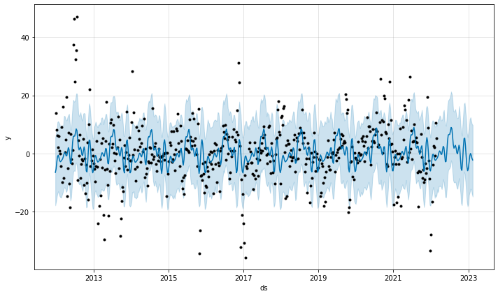
6. Baseline Model- Autoregressive diff Y (ensemble)
Data + Prediction
MSE Chart
Horizon | MSE
1 week | 194.02
2 weeks | 170.97
3 weeks | 20.61
4 weeks | 36.94
5 weeks | 47.11
8 weeks | 68.97
Diff(1) in Drought Risk
Time
Notes:
So the prediction period can be extended for a 15 days circle, roughly 2 weeks. Short term variability, data reported on every tuesday, averaging.
Think carefully in inherent bias in prediction (averaging over things, so better at long-term prediction
Critically thinking the result

Slide 18
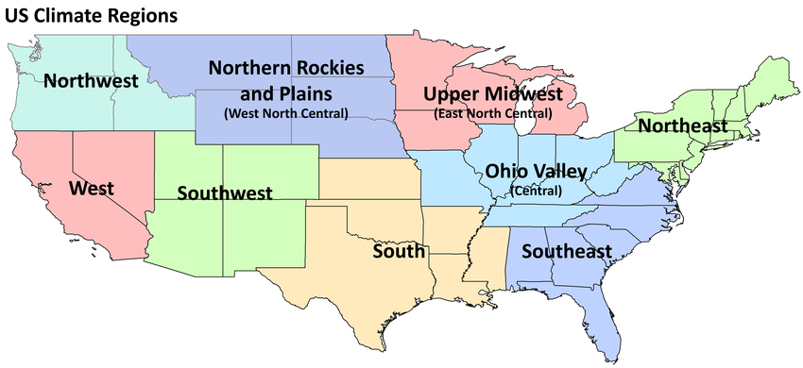
7. Latest results and comparison to the baseline model
More granularity needed in modeling
Regional models: 9 Autoregressive models in total
Notes:
As the mechanism of drought could be intrinsically different across climate regions
We realize maybe we need more granularity in our modeling
nine different climate zones in US
make one model for each region.

Slide 19
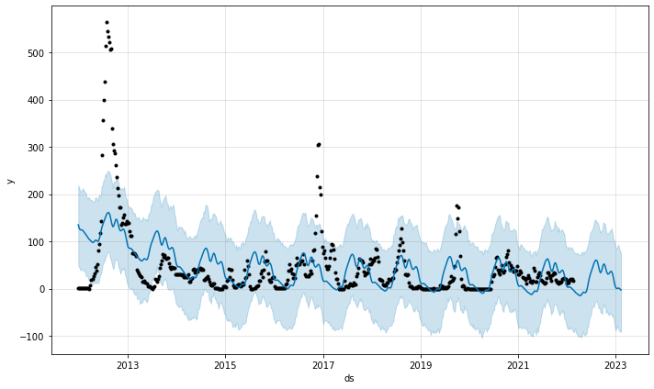
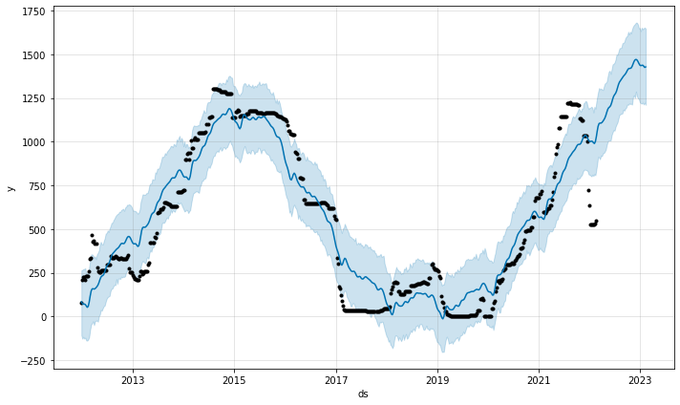
7. Regional models - Y autoregressive
Ohio Valley
West
Drought Risk
Time
Time
variability across climate regions; good models
Notes:
We have seen good and bad models.
For example, if we look at Ohio Valley and West region, the AR model is in general capturing the trend.
For West region, despite the misrepresentation near the tail, in general the model do better job.

Slide 20
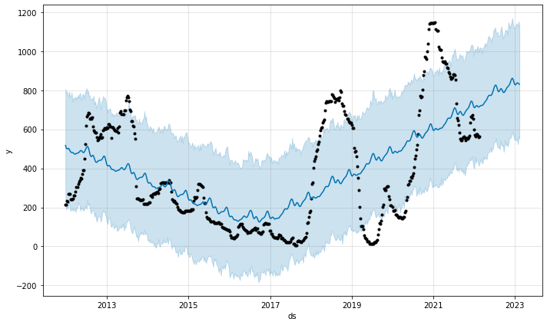
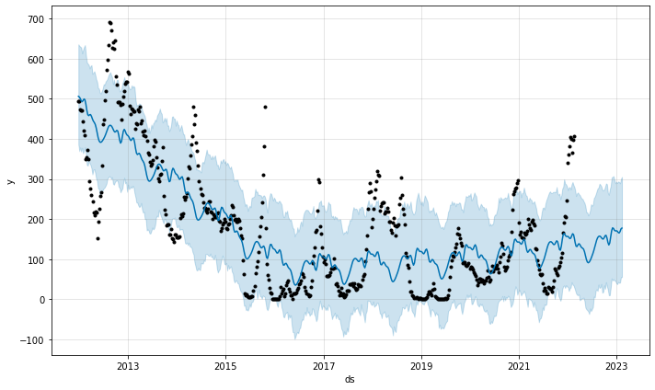
7. Regional models - Y autoregressive
Southwest
South
Drought Risk
Time
Time
variability across climate regions; bad models
Notes:
Here we show two examples for models not capturing the trend.
Southwest region and South.
It’s barely capturing the general trend

Slide 21
7- Regional models- Y autoregressive
Region | 2 weeks | 3 weeks | 4 weeks
Ohio Valley | 543.28 | 2.67 | 31.71
West | 3002.43 | 534.54 | 2596.50
Northwest | 450.73 | 177.55 | 49.76
Northeast | 115.04 | 459.88 | 2.68
Northern R & R | 7743.07 | 1069.49 | 1154.16
South | 3869.22 | 1126.15 | 11606.85
Southeast | 14.55 | 1612.00 | 327.98
Upper Midwest | 9357.98 | 8.194 | 79.37
Southwest | 21820.43 | 2677.14 | 10085.16
Notes:
Finally, here’s an exhaustive table of MSE at different time horizons
we see there exist few blocks we have good prediction, across 2 to 4 week prediction horizon.
And we also have regions that have ridiculously high MSEs, the model is almost meaningless in those areas
Error/ uncertainty is not the enemy to true information; uncertainty itself is information. Uncertainty is risk, and for our task, we are interested in drought risk!

Slide 22
7- Regional models. What to do with high MSEs?
Error/ uncertainty is not the enemy to true information
Uncertainty itself is information
Uncertainty is risk
Notes:
Is the model almost meaningless in those areas?
Error/ uncertainty is not the enemy to true information; uncertainty itself is information. Uncertainty is risk, and for our task, we are interested in drought risk!

Slide 23
8. Lesson Learned / Issue Resolved
For Data:
We are able to combine different piece of information. (Different format, different specification, different sizes, etc.)
For Modeling
A way to show the logic of modeling approach –” layer of knowledge”
Model with only one or two features is not sufficient, current model only does good in 3-4 week horizon.
“One-for-all” seems not working. Need to have region specific prediction→ so we decide to stratify climate regions
Interpretation & analysis

Slide 24

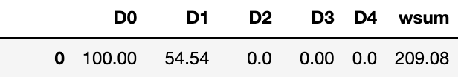
9. Upcoming Plans
(6 weeks left….)
For Data:
Finish water reservoir feature extraction from satellite images by 4/1
For Modeling
OLS approach by region
If some combination outperform, apply more adv models
Categorical vs numerical Y? - exploration
NOAA
SET
SMAP
Y

Slide 25
THANK YOU!

